Slide 1
METALS

Slide 2
Metals; ferrous, non ferrous, alloys
Ferrous metals
· Ferrous metals including: mild steel, high carbon steel, cast and wrought iron
· Availability of stock forms such as sheet, bar, tube and angle
· Applications for ferrous metals such as car body panels, tools, white goods and machine parts
Non-Ferrous metals
· Non-ferrous metals including: aluminium, copper, zinc, gold, silver and titanium
· Availability of stock forms e.g. sheet, tube, ingot
· Applications for non-ferrous metals such as kitchen ware, jewellery, food wrapping, cans and electronics
Alloys
· Ferrous alloys including: stainless steel, high speed steel and die (tool steel)
· Applications for ferrous alloys e.g. kitchen ware, street furniture, cutting and press tools
· Non-ferrous alloys including; bronze, brass, pewter, and duralumin/aluminium alloys
· Applications for non-ferrous alloys such as ornaments, valves, boat fittings, sculpture, coins and jewellery

Slide 3
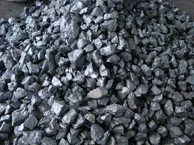
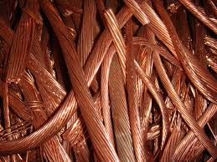
DIFFERENCES BETWEEN METALS
FERROUS
Contains Iron (Fe)
FErrous
NON FERROUS
Contains NO Iron (Fe)
NON FErrous

Slide 4
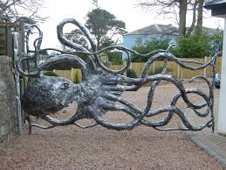
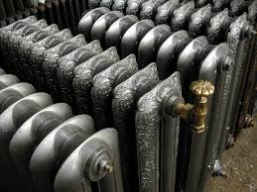
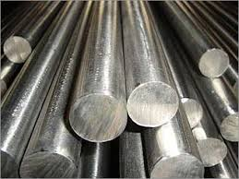
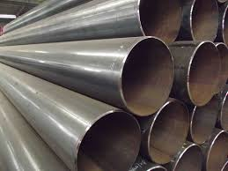
FERROUS METALS
WROUGHT IRON
Ap: gates and fencing.
CAST IRON
Ap: machine parts, engines, disc brakes.
MILD STEEL
Ap: white goods, nuts and bolts, car body panels.
HIGH CARBON STEEL
Ap: hand tools, scribers, chisels.

Slide 5
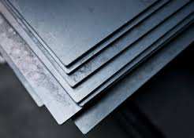
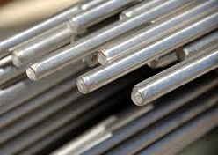
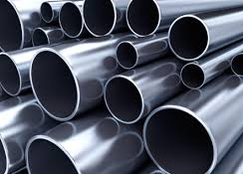
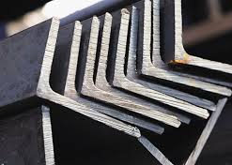
FERROUS STOCK FORMS
SHEET
Ap: used with press forming to make car body parts, cans etc.
BAR
TUBE
ANGLE
Ap: used to make corner edges secure and build structures.

Slide 6
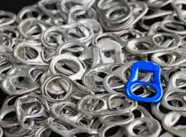
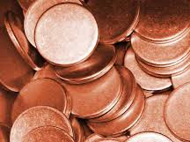
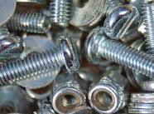

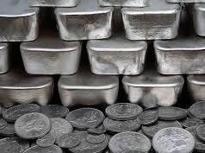
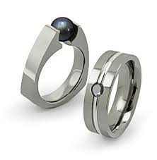
NON-FERROUS METALS
ALUMINIUM
P: ductile, flexible, good strength to weight.
Ap: kitchen ware, food wrapping and cans.
COPPER
P: ductile and dureable.
Ap: electronics, pipes or pan bottoms.
ZINC
P: fairly strong and durable.
Ap: coatings for screws and bolts, can be die cast for small high detail pieces.
GOLD
P: expensive, lusterous, durable.
Ap: used to make expensive jewellery and electronics.
SILVER
P: fairly expensive and durable.
Ap: used to make jewellery, cutlery and in photographic film.
TITANIUM
P: very strong and durable.
Ap: used to make expensive jewellery, surgical applications (hip replacements).

Slide 7
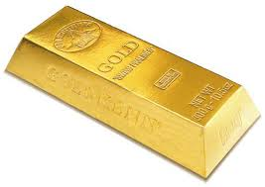
NON-FERROUS STOCK FORMS
Also:
Tubes, sheets and bars.
INGOT
Ap: used by melting down – can be used for casting.

Slide 8
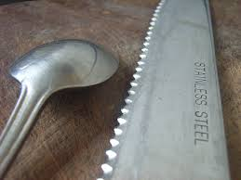
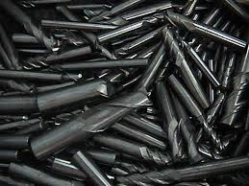
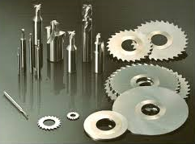
FERROUS ALLOYS
STAINLESS STEEL
P: fairly strong and durable.
Ap: used to make kitchen ware and street furniture.
HIGH SPEED STEEL
P: durable at high temperatures – not brittle.
Ap: used to make press tools.
DIE (TOOL) STEEL
P: durable at high temperatures – not brittle.
Ap: used to make cutting tools.

Slide 9
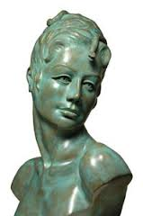
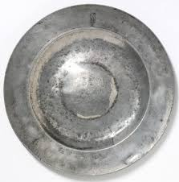
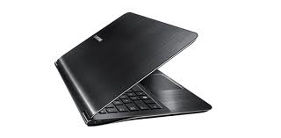
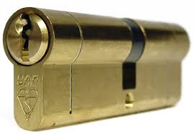
NON-FERROUS ALLOYS
BRONZE
A: starts browny/gold weathers into greens.
P: fairly strong and durable.
Ap: used to make sculptures, coins.
PEWTER
A: light, dull grey with slight sheen.
P: durables, soft metal, lower melting point.
Ap: used to make jewellery.
BRASS
A: golden in colour.
P: durable.
Ap: used to make instruments, boat fittings and coins.
DURALUMIN
A: darker silver.
P: durable and good strength to weight ratio.
Ap: casings, aircraft structures.

Slide 10
Metals; Fabrication and Forming
Fabrication Methods
· Permanent joining methods such as: soldering, brazing, riveting, welding (including oxy-acetylene, MIG and spot)
· Temporary joining methods such as self-tapping screws, machine screws, nut and bolt
Forming Methods
· press forming, cupping and deep drawing, drop forging and wrought iron forging techniques
Redistribution Methods
· Casting, spinning and pressing
Finishing Methods
· Primers including zinc and red oxide primers (epoxy based)
· Paints including acrylic and cellulose based
· Method of application including: brush, spray, dip and powder coating
· Plating including: chrome, silver and tin plated
· Galvanizing
· Dip coating with polymers
· Brushed/polished stainless steel

Slide 11
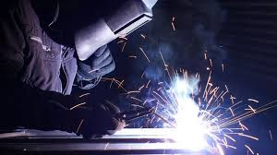
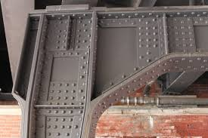
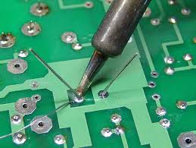
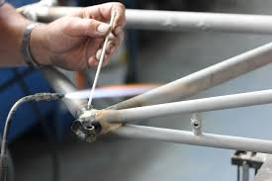

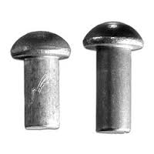
METAL FABRICATION: PERMENANT FIXINGS
WELDING
Such as Spot, oxy-acetylene and MIG.
Ap: used to join together sheet materials and fusing of different shaped metals.
RIVETING
Such as Pop Rivet and Solid Rivets.
Ap: used to join sheet metals together.
SOLDERING
Ap: secure small pieces e.g. jewellery or electronic components.
BRAZING
Ap: join pipes or tubular pieces of metal.

Slide 12
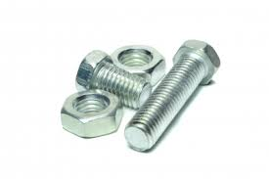
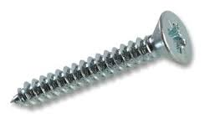
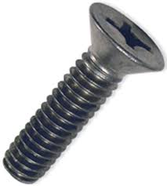
METAL FABRICATION: TEMPORARY FIXNINGS
NUTS & BOLTS
Ap: follow a pre-cut thread, the nuts then lock the bolt in place.
MACHINE SCREWS
Ap: follow a pre-cut thread and secures pieces together.
SELF TAPPING SCREWS
Ap: cut their own thread as they are screwed into material.

Slide 13
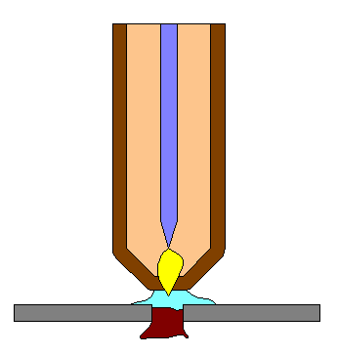
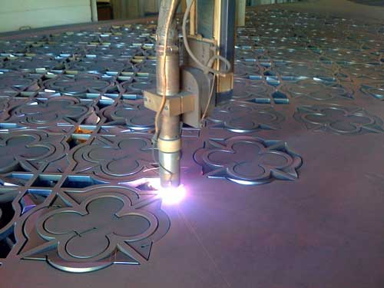
METAL WASTING PROCESSES
PLASMA CUTTER
Little to no finishing needed.
Gas (air)
Electrode –ve charge
Shielding gas
PLASMA & LASER CUTTING
CNC machines that operate by cutting on plotted pathways.
Plasma arc
Material being cut with +ve charge

Slide 14
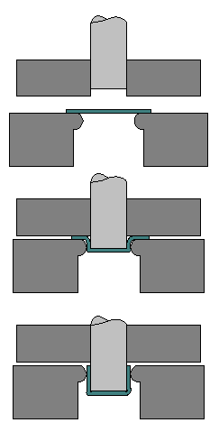
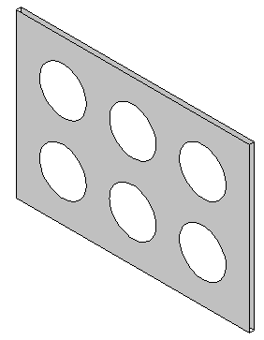
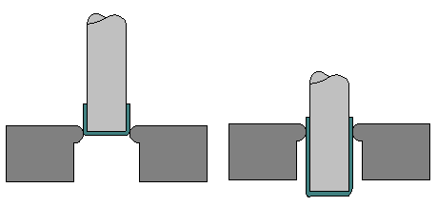
METAL FORMING: MAKING CANS
These processes cause a thinning of the material as it stretches – think about blue tac when you stretch it.
Punch
Blank
Die
Punch
DEEP DRAWING
The material is then pushed further through more stages to elongate the shape.
BLANKING
Blanks are created by punching shapes out of sheet metal.
CUPPING
A blank is clamped in place.
A punch is lowered and presses out the shape.

Slide 15
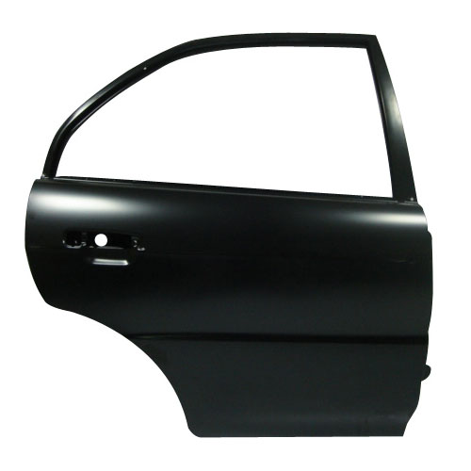
METAL FORMING: PRESS FORMING
Die
PRESS FORMING
A metal sheet is clamped down, a hydraulic press is then lowered onto the material.
VIDEO

Slide 16
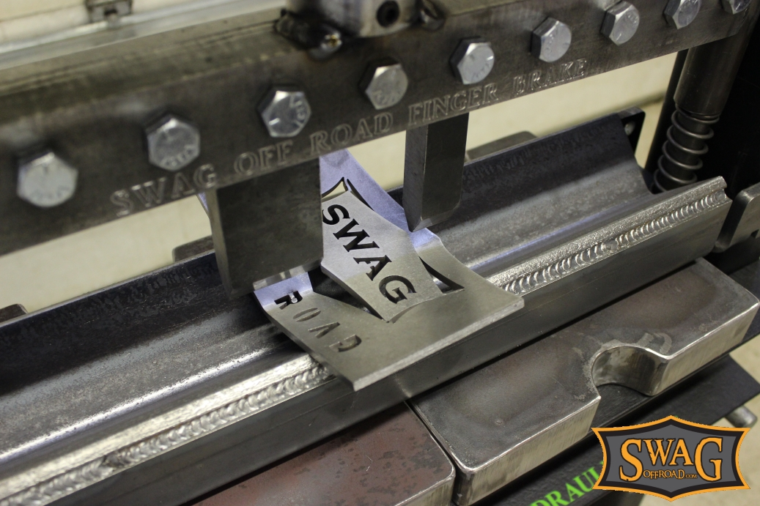
PRESS FORMING
If a material is to be press formed it must be a ductile metal
When the material is stretched it hardens – therefore increasing it’s structural strength
Folding material gives greater stiffness and rigidity

Slide 17
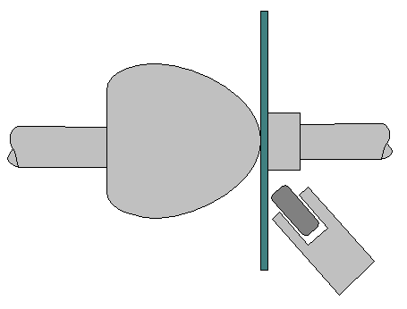
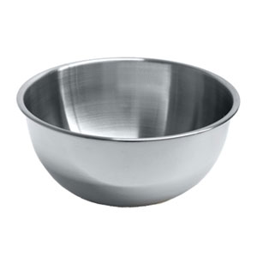
METAL FORMING: SPINNING
Clamps material by force
Mandrel
Forming tool
SPINNING
A punch with details on is lowered and pressed into a blank.
VIDEO

Slide 18
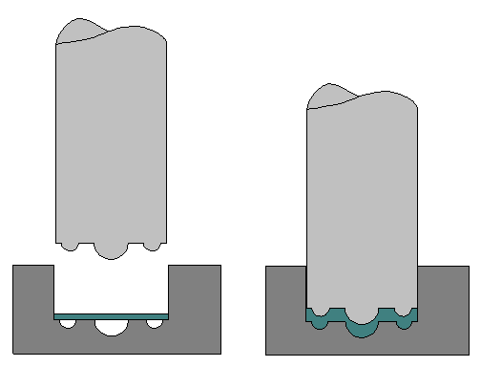
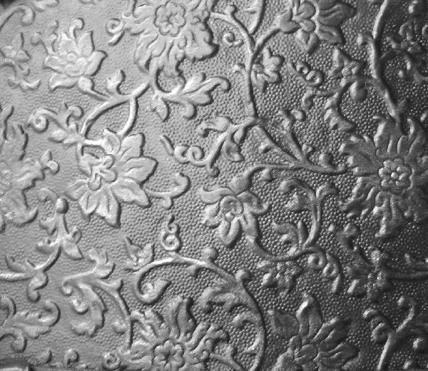
METAL FORMING: EMBOSSING
Punch
Blank
EMBOSSING
A punch with details on is lowered and pressed into a blank.

Slide 19
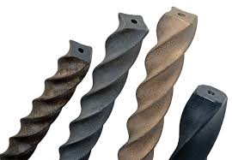
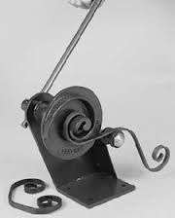
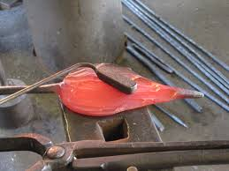
METAL FORMING: FORGING
DROP FORGING
The upper half is attached to a hammer which drops , forcing the metal into the shape of the die.
This gives a product great strength as the grain of the material follows the shape.
Ap: used to create lots of identical products – e.g. spanners or medical replacements.
WROUGHT IRON FORGING
Can be carried out by hand or machine, they can be bent, drawn over anvils, twisted or scrolled. The metal must be hot to avoid the risk of fracturing.
Ap: fencing, decorative work.

Slide 20
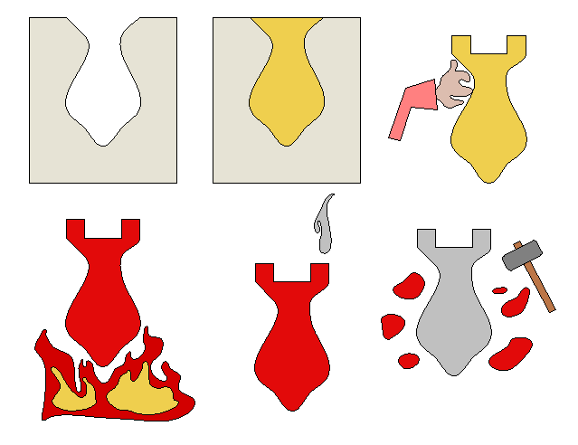
METAL REDISTRIBUTION: INVESTMENT CASTING
Clay sprayed on
Runner and riser added
Wax poured in
INVESTMENT CASTING PROCESS:
A die is made.
Melted wax is poured into the die and left to set.
A runner and riser are created and the wax piece is either sprayed with, or submerged into clay.
The piece is then baked in a kiln until hard, the wax is then poured out.
Molten metal is then poured into the mould until it appears in the riser.
After cooling the mould is broken open to reveal the metal product.
Die
Clay/ceramic coating is smashed off
Baking in the kiln
Molten metal poured in

Slide 21
INVESTMENT CASTING
ADVANTAGES
DISADVANTAGES
Good finishes
Good level of accuracy
No split line (from a mould)
Can make complicated shapes that can’t be made any other way
High cost
Size is limited by weight

Slide 22
METAL REDISTRIBUTION: SAND CASTING
The other half is also filled with sand but also has a runner and riser placed in, the sand is packed around these
Pattern comes in two parts, the half is placed upside down against a mould board and packed with sand
Molten metal is poured in, once cool the product is removed and the runner and riser are cut away
The templates are removed, and the first piece is flipped over – locating pins help the alignment

Slide 23
SAND CASTING
ADVANTAGES
DISADVANTAGES
Makes complex shapes
Use cores to make hollow sections
Can be automated
Good for small runs
Poor surface finish – will need machining
Not as accurate as other methods
Low output rate

Slide 24
METAL REDISTRIBUTION: COLD CHAMBER DIE CASTING
Moving moulds and plates
Fixed mould
Molten metal poured from ladle or crucible
Ejector pin
Hydraulic ram
Fixed plate

Slide 25
METAL REDISTRIBUTION: HOT CHAMBER DIE CASTING
Mould halves
Ejector pins
Hot chamber containing metal
Hydraulic ram
Goose neck

Slide 26
METAL REDISTRIBUTION: GRAVITY DIE CASTING
Mould halves
Runner
Gas rings around the sides of the die cast chamber keep the die hot and then ensure the product cools evenly.
Gas flame all around the edges
Product

Slide 27
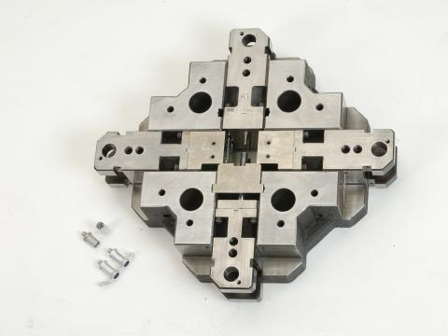
METAL REDISTRIBUTION: MULTI-SLIDE DIE CASTING
Watch a video from the TSOK websites, they are specialists in multi-slide die-casting.

Slide 28
DIE CASTING
ADVANTAGES
DISADVANTAGES
Makes complex shapes
High quality surface finish
High level of accuracy
High output
Some alloys will have a lower melting point – therefore less energy is needed to melt the metal
High cost to set up – only suitable for long runs

Slide 29
METAL FINISHING
PRIMERS: zinc and red oxide primers (epoxy based)
PAINTS: need to be cellulose or acrylic based
Applications with brushes, dips and powder coating.
PLATING: with chrome, silver and tin
Galvanizing with zinc.
DIP COATING: using polymers - watch a video here.
Brushed and Polished Steel
POWDER COATING: watch a video here.

